Slide 1
TASK MANAGEMENT SYSTEM

Slide 2
CASE STUDY PROBLEM STATEMENT
Task Management System is near to a day to day tracker for the tasks assigned to the employee.
Employee can view the task assigned for the day, can view all pending task , can request for more time to complete the task, can edit his/her profile, can apply for leave.
Admin can add/delete/edit any task and employee, can approve leave, can approve time extension requested by employee to complete the task.
This application is helpful for the organization.

Slide 3
ACTORS
ADMIN:
Add/delete/edit any task and employee
Assign task
Approve leave
View task
View pending task
Approve task extension
Add comments

Slide 4
ACTORS
EMPLOYEE:
View all tasks
View pending tasks
Can ask for more time to complete the task
Edit his/her profile
Apply for leave

Slide 5
REQUIREMENTS
Admin Service add/Delete, View/Modify employee and task details.
Approval of task extension date requested employee.
Approve leave for employee.
Employee can view all task assigned.
Employee can request for time extension for task.
Employee can view/edit profile.
Employee can apply for leave

Slide 6
FUNCTIONS USED
Add Employee : helps to sign up a new employee with all the details
Delete Employee : helps to set the employee status as deleted, once he leaves the company
Edit Employee : helps to edit the details of the employee
addTask : helps to add a task
assignTask : helps to assign task
editTask : helps to edit the task
deleteTask : helps to delete task
viewTask: allows employee to view the tasks
viewPendingTasks: allows employee to view the pending task
requestTaskExtension : allows employee to request for task extension
approveTaskExtension : allows admin to approve the request for extension
Apply leave: allows the employee to apply for leave
Approve leave: allows the admin to approve leave
Comments: Can add commets for a particular task if required

Slide 7
ENTITY RELATIONSHIP DIAGRAM

Slide 8
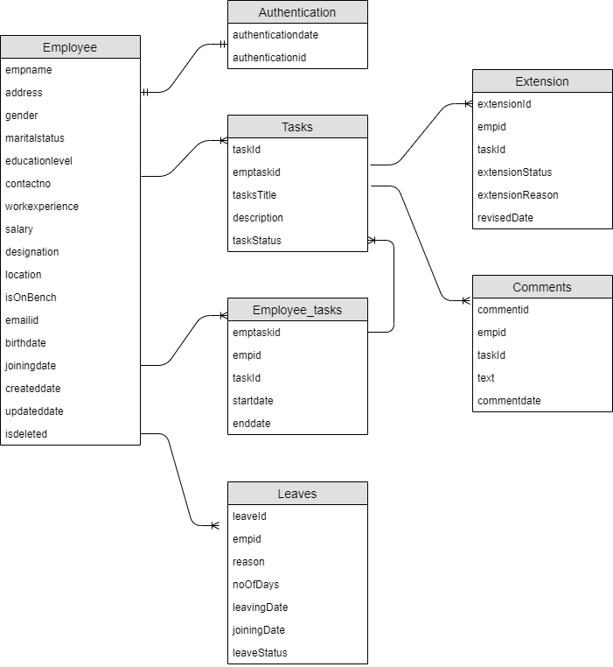

Slide 9
USE CASE DIAGRAM
This project has 2 actors, the Admin and the employee.The use case describes the roles of them in the system.

Slide 10
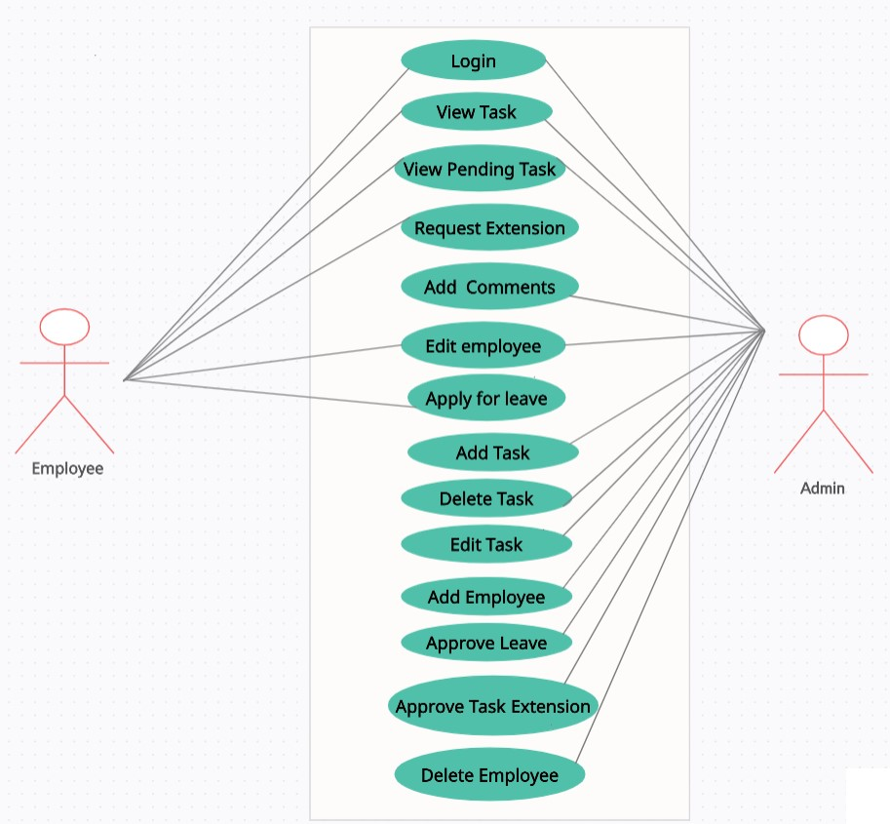

Slide 11
ACTIVITY DIAGRAM
Below is the list of functionalities this project has:
Add Employee
Delete Employee
Edit Employee
addTask
assignTask
editTask
deleteTask
viewTask
viewPendingTasks
requestTaskExtension
approveTaskExtension
Apply leave
Approve leave
Comments

Slide 12
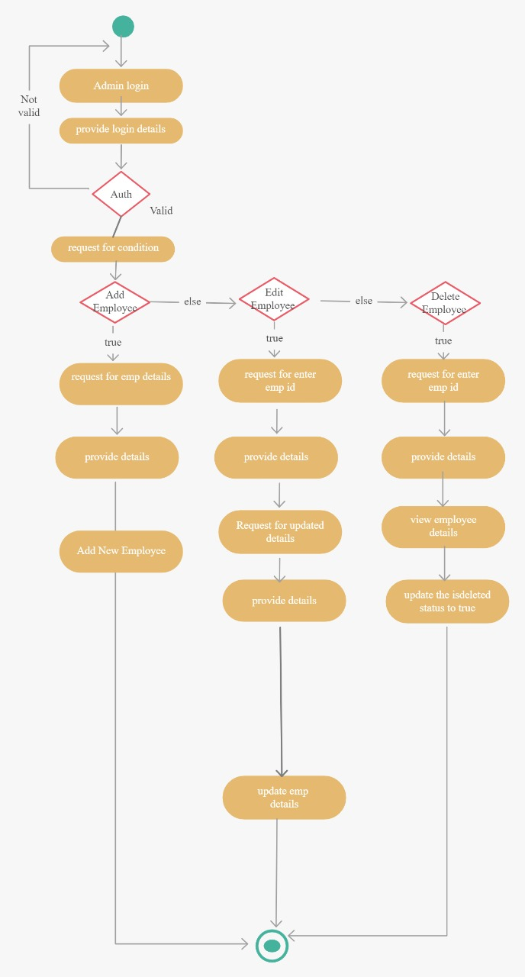
Add employee, delete Employee, edit Employee

Slide 13
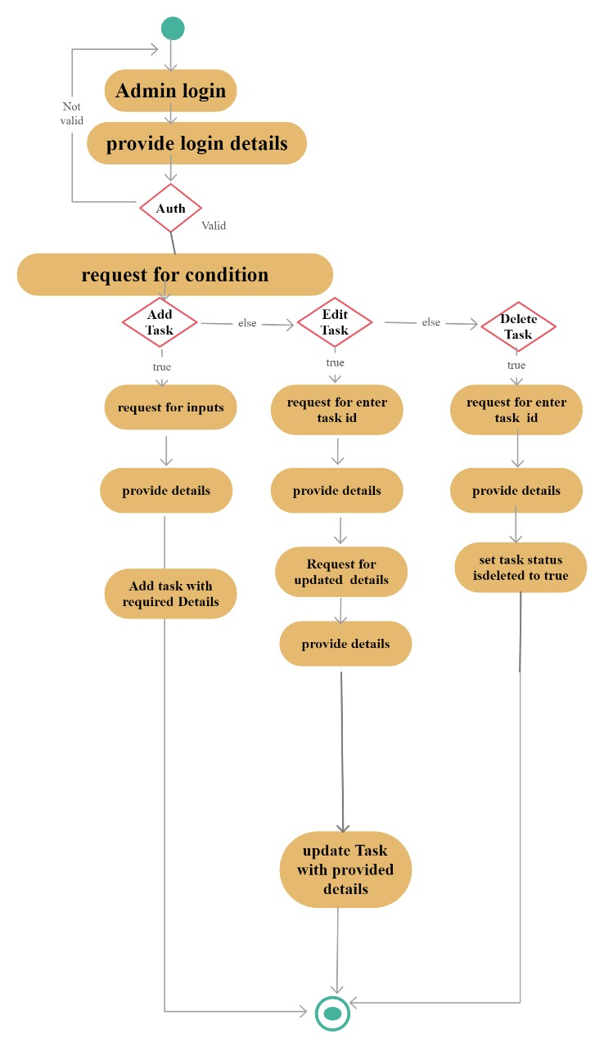
2.Add Task, Edit Task, Delete Task

Slide 14
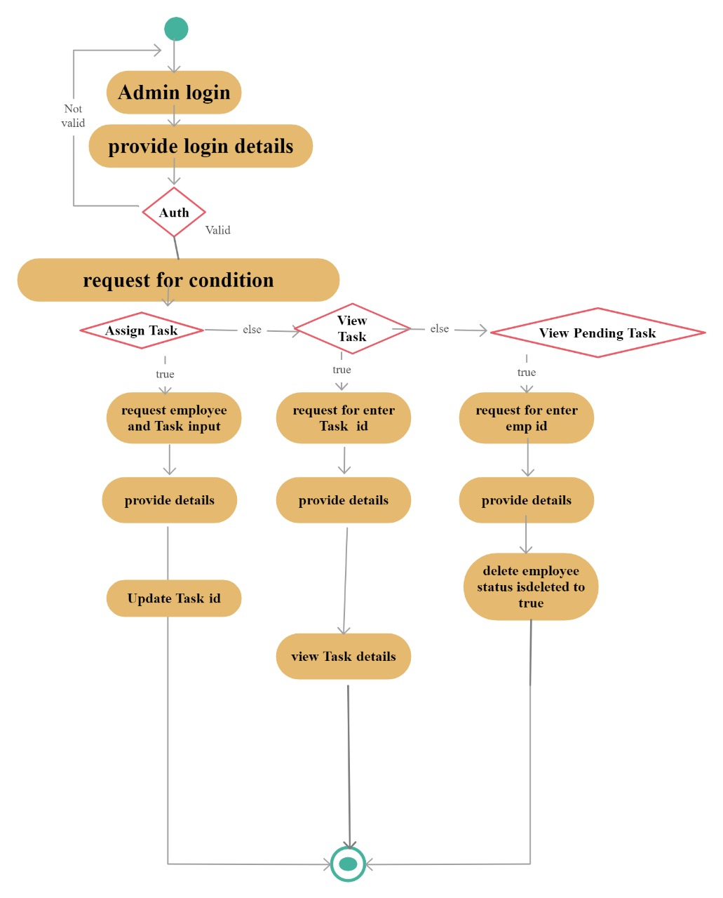
3. Assign Task, View Task, View Pending Task

Slide 16
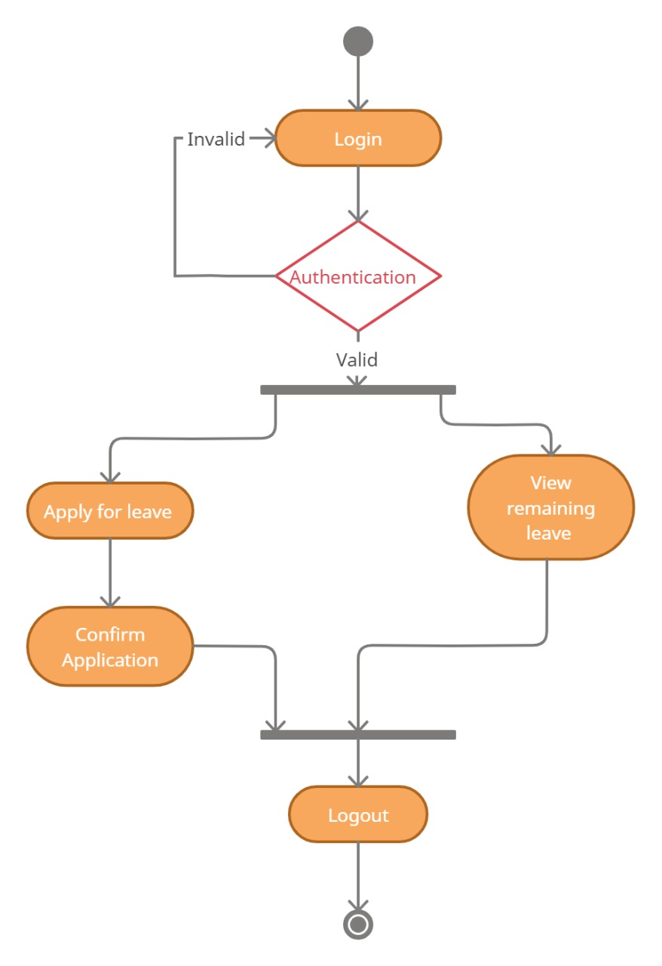
4.Apply For leave

Slide 17
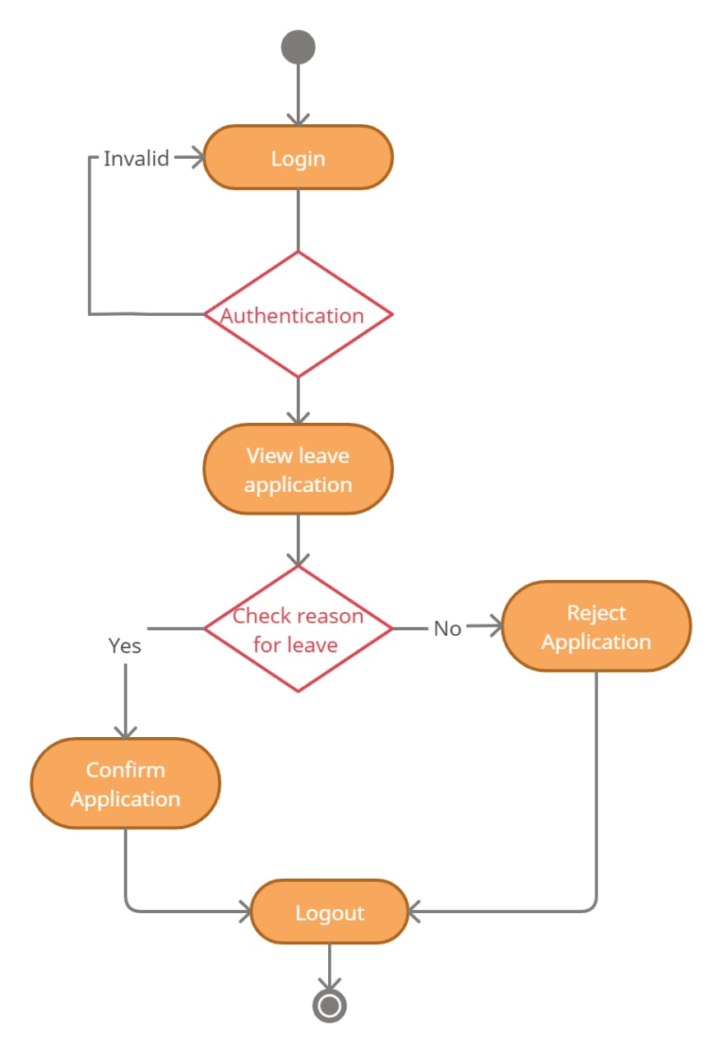
5. Approve leave

Slide 18
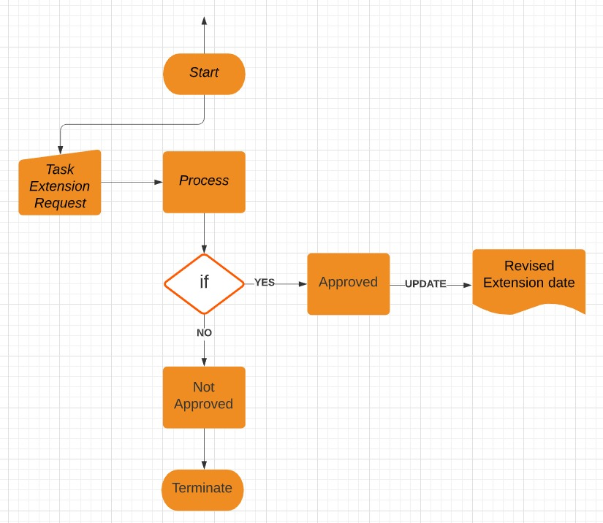
6.Apply and approve task extension

Slide 19
THANKYOU

